Slide 1
The Happiness Project Inspired by Shalin Shah
“Take your time to enjoy nature, enjoy love and enjoy your life!”
-Shalin Shah

Slide 2
The Happiness Project- Vision
CREATE POSITIVE PERSONAL CHANGE
Invest in yourself and give to others!
“If I can inspire others to live more positive and happy lives…even for just 5 minutes then I've added some good to the world. If my story can make a guy say, “You only live once, I'm gonna enjoy myself right now and go buy a Popsicle from the ice cream cart guy in the parking lot," and that makes him happier for a second, then my mission is accomplished.” -Shalin

Slide 3
The Happiness Project
Vision: Create Positive Personal Change
Motto: Invest in yourself and give to others
Mission: Form clubs in high-schools that help students create positive personal change so that they can be the best versions of themselves and live happy and fulfilled lives.
Core Values:
Personal Enlightenment
Service and Helping Others
Appreciation for Life and Nature
Creativity

Slide 4
Club Meeting Ideas and Activities
Personal Enlightenment
Journaling
Service and Helping Others
Random Acts of Kindness
Creativity
Painting/sketching
Appreciation for Life and Nature
Nature hikes
Building Lego
Color me mine
Going to museums, films, theater
Kayaking
Star gazing
Kite flying
Goal setting
Stepping outside your comfort zone
Gratitude Exercises
Meditation/Yoga
Philanthropy Week
Mentorship to underprivileged kids- Pay it forward
Partner with UNICEF and Key Club on activities

Slide 5
Invest In Your Future
Getting into a good college is a core focus for most High School students so here is how forming or joining The Happiness Project can help boost your college application…
Leadership: Colleges look favorably upon those that form new school clubs. Additionally, there will be ample leadership opportunities to spearhead club events and hold leadership positions in the club.
Community service hours: Giving to others is a key component of happiness. You will be able to earn community service hours while performing those activities.

Slide 6
The inspiration for The Happiness Project
Shalin’s Philosophy

Slide 7
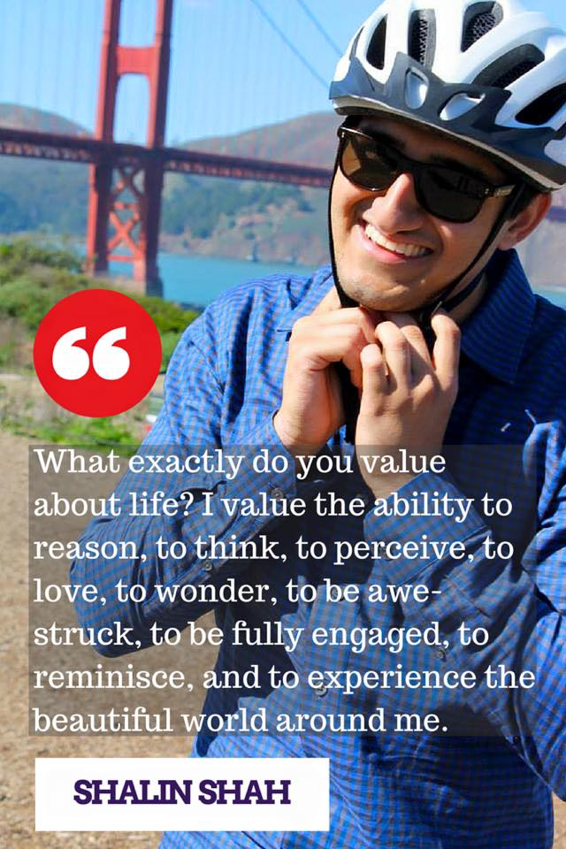

Slide 8
Steps to a Masterful Mind
Build self confidence
Cultivate an appreciation for life
Creativity
Service and helping others

Slide 9
1. Build Self-Confidence
Be positive:
Stop searching for meaning, there is no external meaning in this world that we will be able to comprehend. Instead, begin to ascribe meaning to the things you value and find important in life. One should live in a way such that their efforts are not futile to them since they are in accordance with their ascribed meaning.
Be true:
Be self-confident and proud of the quirks and idiosyncrasies of who you are because you are part of an ecosystem that would not be the same without your existence.
“Success means having the courage, the determination, and the will to become the person you believe you were meant to be.” – George Sheehan
Be you:
Do not try to impress others and make them jealous, do what you want to do, only concern yourself with your own decisions and actions. Don’t avoid doing things out of fear of being judged by others.
Do not compete with others senselessly or compare yourself with others
Do not judge people (you are no better than everyone else and they are no better than you, don't mind yourself with what others choose to do, truly wish for the happiness of others)

Slide 10
2. Cultivate Appreciation for Life
Observe:
The greatest joys come from the simple things in life. Appreciate the simple things. Appreciate nature.
Staring at the night sky makes me wonder. Watching a magnificent sunset makes me wonder. Listening to a beautiful song makes me wonder.
Appreciate:
Accept that everything is beautiful in its own way, you just need to adjust your perspective to be able to appreciate the beauty of it
Reciprocate:
Show appreciation and thanks to everyone for even very small acts
Say Thanks- This simple gesture has the power of making others feel valued and special and as though they have made a sincere difference

Slide 11
3. Creativity
To live life to the fullest. To flourish rather than exist, to thrive rather than to get by.
I want to learn as much as possible during my time on earth. There are so many perspectives to be explored and I want to experience as many different sensations as possible to move myself one step closer to the bigger picture of ultimate reality.
Aspire to be a Renaissance Man (paint, write poetry, sculpt), the Most Interesting Man in the World (live an interesting life).

Slide 12
4. Service and Helping Others
To leave this world in a better place than it was before.
I want everyone else to be as happy as they possibly can be. I want to help them reach their wildest ambitions.
I want to volunteer and give to the less fortunate. I want to take my more fortuitous situation and spread it to others. I want to help them attain equality of opportunity, whether it be through education, or something as trivial as a clean water supply, a roof or shoes

Slide 13
Thank You!
“At the end of the day happiness is all that truly matters. So live, love, and laugh it up” -Shalin

